Slide 1
Number system - 3
Properties of remainder
Concept of last digit

Slide 2
N divided by A
Remainder = 0
(N is divisible by A)
Factors, HCF, Properties of factors, properties and applications of HCF
Multiples, LCM, properties and applications of LCM
Remainder ≠ 0
Properties of remainder, Concept of last digit

Slide 3
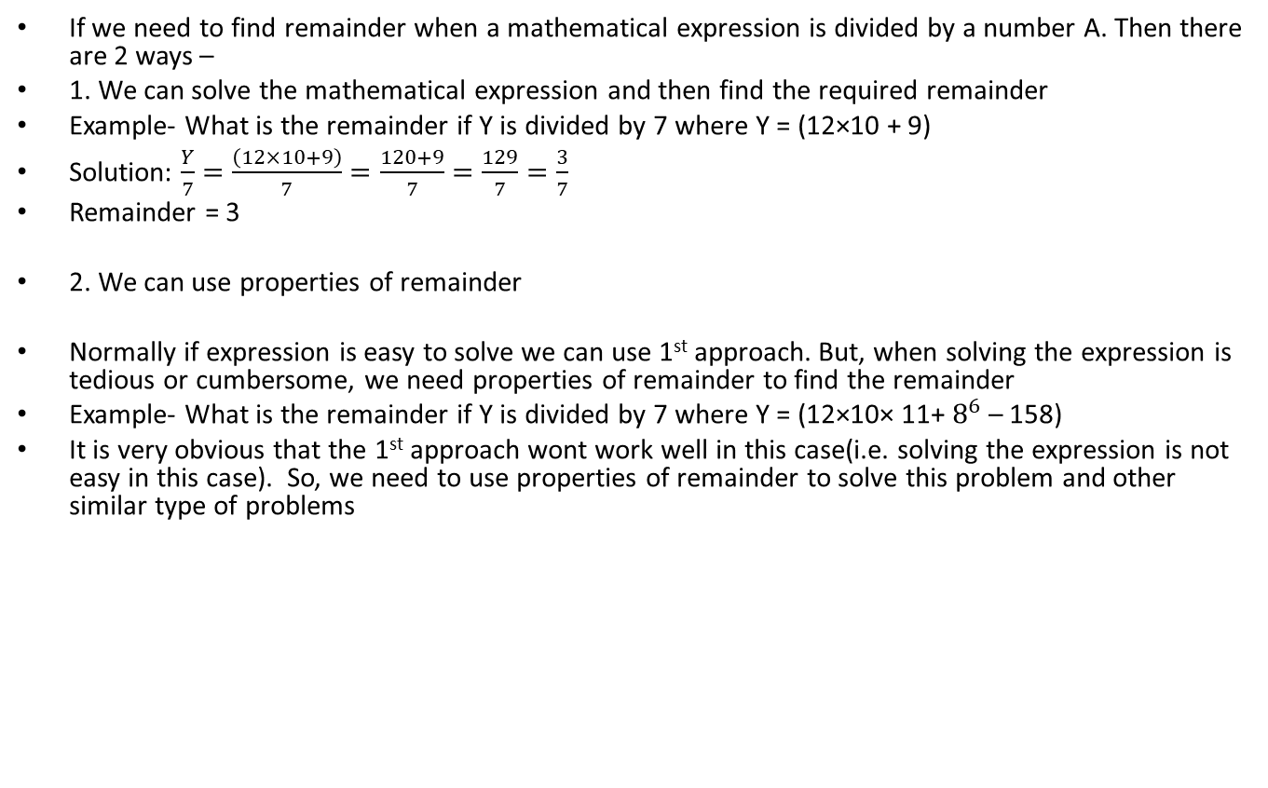
Properties of remainder
If we need to find remainder when a mathematical expression is divided by a number A. Then there are 2 ways –
1. We can solve the mathematical expression and then find the required remainder
Example- What is the remainder if Y is divided by 7 where Y = (12×10 + 9)
Solution: $\frac{Y}{7}=\frac{\left(12×10+9\right)}{7}=\frac{120+9}{7}=\frac{129}{7}=\frac{3}{7}$
Remainder = 3
2. We can use properties of remainder
Normally if expression is easy to solve we can use 1st approach. But, when solving the expression is tedious or cumbersome, we need properties of remainder to find the remainder
Example- What is the remainder if Y is divided by 7 where Y = (12×10× 11+ $8^{6}$ – 158)
It is very obvious that the 1st approach wont work well in this case(i.e. solving the expression is not easy in this case). So, we need to use properties of remainder to solve this problem and other similar type of problems

Slide 4
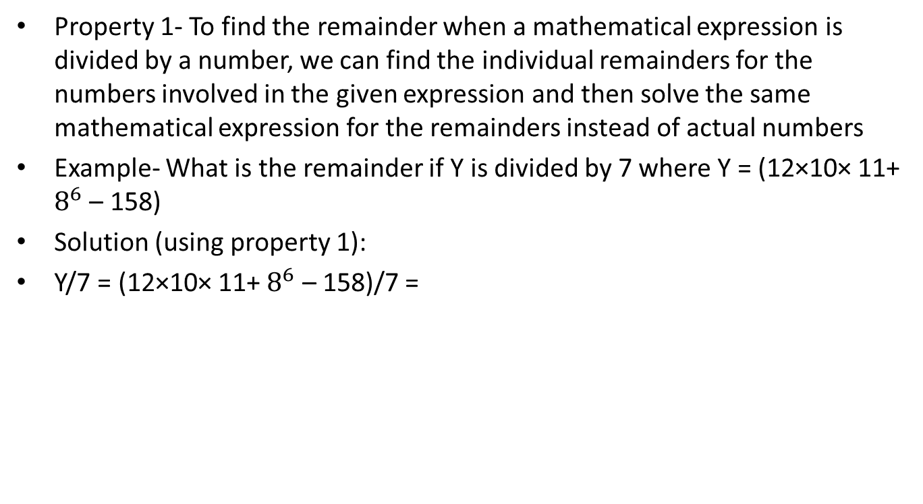
Property 1
Property 1- To find the remainder when a mathematical expression is divided by a number, we can find the individual remainders for the numbers involved in the given expression and then solve the same mathematical expression for the remainders instead of actual numbers
Example- What is the remainder if Y is divided by 7 where Y = (12×10× 11+ $8^{6}$ – 158)
Solution (using property 1):
Y/7 = (12×10× 11+ $8^{6}$ – 158)/7 =

Slide 5
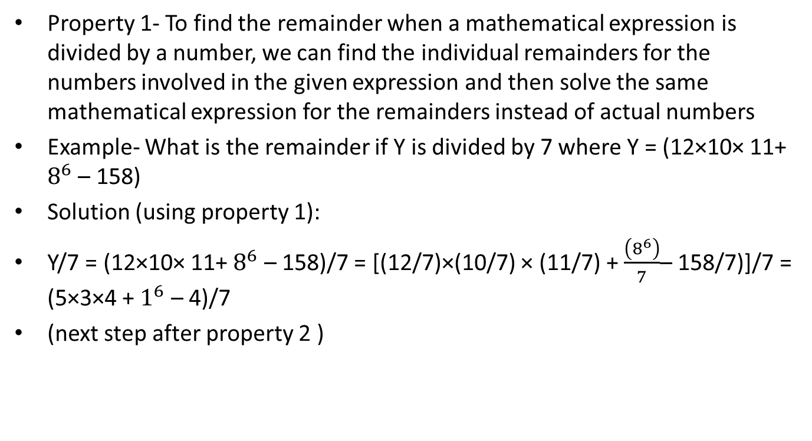
Property 1
Property 1- To find the remainder when a mathematical expression is divided by a number, we can find the individual remainders for the numbers involved in the given expression and then solve the same mathematical expression for the remainders instead of actual numbers
Example- What is the remainder if Y is divided by 7 where Y = (12×10× 11+ $8^{6}$ – 158)
Solution (using property 1):
Y/7 = (12×10× 11+ $8^{6}$ – 158)/7 = [(12/7)×(10/7) × (11/7) + $\frac{\left(8^{6}\right)}{7}$– 158/7)]/7 = (5×3×4 + $1^{6}$ – 4)/7
(next step after property 2 )

Slide 6
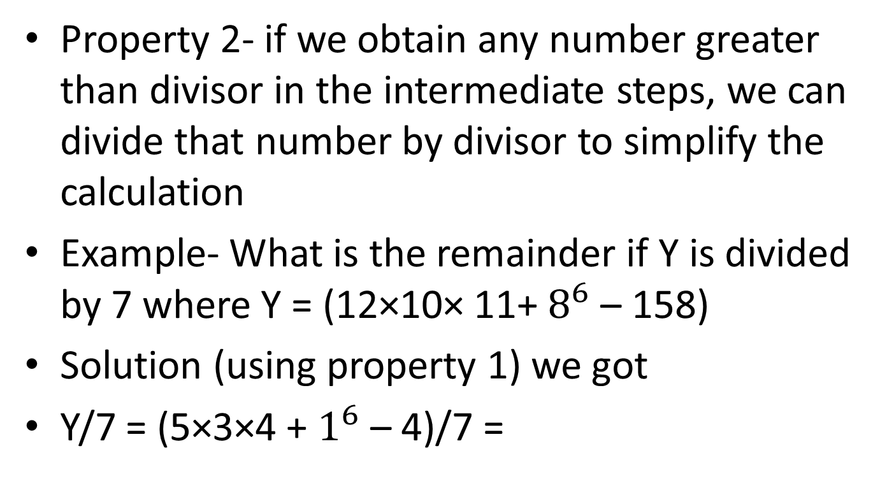
Property 2
Property 2- if we obtain any number greater than divisor in the intermediate steps, we can divide that number by divisor to simplify the calculation
Example- What is the remainder if Y is divided by 7 where Y = (12×10× 11+ $8^{6}$ – 158)
Solution (using property 1) we got
Y/7 = (5×3×4 + $1^{6}$ – 4)/7 =

Slide 7
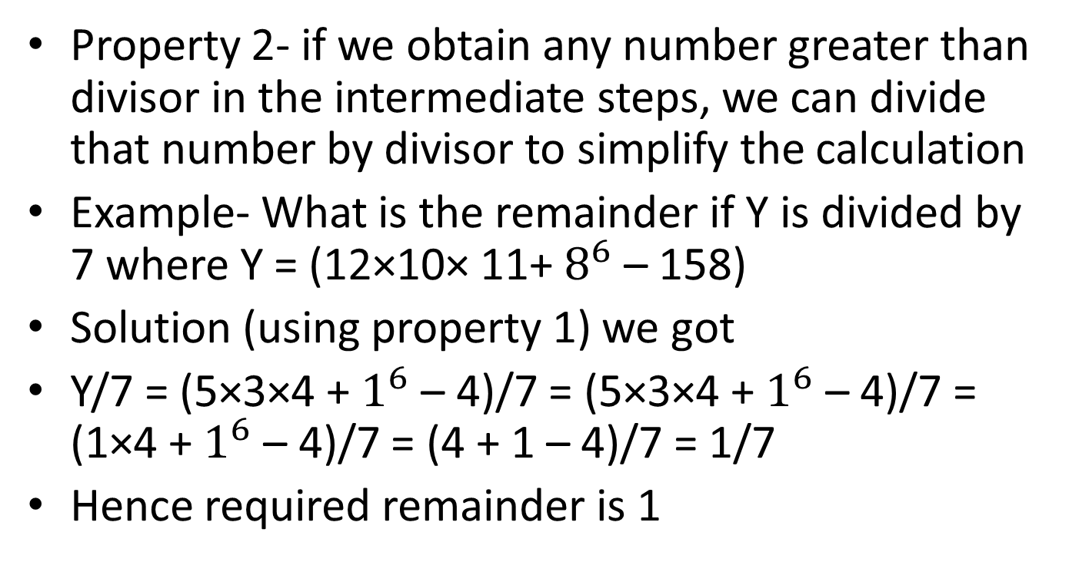
Property 2
Property 2- if we obtain any number greater than divisor in the intermediate steps, we can divide that number by divisor to simplify the calculation
Example- What is the remainder if Y is divided by 7 where Y = (12×10× 11+ $8^{6}$ – 158)
Solution (using property 1) we got
Y/7 = (5×3×4 + $1^{6}$ – 4)/7 = (5×3×4 + $1^{6}$ – 4)/7 = (1×4 + $1^{6}$ – 4)/7 = (4 + 1 – 4)/7 = 1/7
Hence required remainder is 1

Slide 8
Property 3
Property 3- (Concept of negative remainder)
We can use negative remainder at any step to simplify the calculation for remainder of a given mathematical expression. But, the final remainder must be positive. (if final remainder obtained is negative, we must convert it to positive)
Negative remainder - For every positive remainder there is an equivalent negative remainder and vice versa. For example if divisor is 7. Then the equivalent negative remainder for 2 is -5 and equivalent positive remainder for -4 is 3
(lets take a practical example with divisor 7. Today is Tuesday. The day after 12 days is like 12/7 = 5. The day after 12 days is same as day after 5 days i.e. Sunday. Now the day which was 2 days before today is also Sunday. So, practically we can see for divisor = 7, the remainders 5 and -2 are same.
Use of negative remainder-
Example: What is the remainder if K is divided by 25 where K = (23×24× 21)
Solution : K/25 = (23×24× 21)/25

Slide 9
Property 3
Property 3- (Concept of negative remainder)
We can use negative remainder at any step to simplify the calculation for remainder of a given mathematical expression. But, the final remainder must be positive. (if final remainder obtained is negative, we must convert it to positive)
Negative remainder - For every positive remainder there is a equivalent negative remainder and vice versa. For example if divisor is 7. Then the equivalent negative remainder for 2 is -5 and equivalent positive remainder for -4 is 3
(lets take a practical example with divisor 7. Today is Tuesday. The day after 12 days is like 12/7 = 5. The day after 12 days is same as day after 5 days i.e. Sunday. Now the day which was 2 days before today is also Sunday. So, practically we can see for divisor = 7, the remainders 5 and -2 are same.
Use of negative remainder-
Example: What is the remainder if K is divided by 25 where K = (23×24× 21)
Solution: K/25 = (23×24× 21)/25
If we multiply any 2 numbers from given 3 numbers in mathematical expression given in above example, we will waste too much of time. So, better to use negative remainder
K/25 = (23×24× 21)/25 = (23×24× 21)/25 = -8/25
So, required remainder is -8 = -8+25 = 17

Slide 10
Property 4
Property 4- Dividing mathematical expression and divisor by same number (say m)
In many cases we can divide the mathematical expression and the given divisor by same number to simplify the solution
Example- What is the remainder if M is divided by 100 where M = (27×96×28×26)
Solution: M/100 = (27×96×28×26)/100
In this case solving 27×28×26 is tedious task
We cannot even use negative remainder in this case.

Slide 11

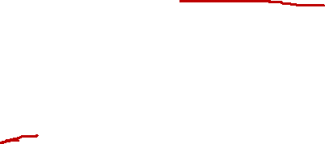
Property 4
Property 4- Dividing mathematical expression and divisor by same number (say m)
In many cases we can divide the mathematical expression and the given divisor by same number to simplify the solution
Example- What is the remainder if M is divided by 100 where M = (27×96×28×26)
Solution: M/100 = (27×96×28×26)/100
In this case solving 27×28×26 is tedious task
We cannot even use negative remainder in this case.
So, its best to divide both mathematical expression and divisor (i.e. 100) by 4
M/100 = (M/4)/(100/4) = {(27×96×28×26)/4}/(100/4) = (27×24×28×26)/25
Now, it can be solved easily.
M/100 = (27×24×28×26)/25 = (27×24×28×26)/25 = -6/25 = 19/25
Important – In such cases, the remained obtained by this property must be multiplied by the number by which both mathematical expression and divisor were divided
So, 19/25 = 76/100.
Hence, required remainder is 76
(25 is remainder for 25 and not 100. So, we must multiply 19 by 4 to find the correct remainder)

Slide 12
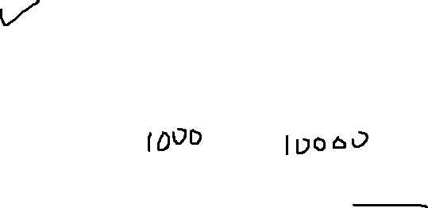
Last digit n last 2 digits
Last digit – The last digit of any number or a mathematical expression is the remainder when the given number or mathematical expression is divided by 10
Last 2 digits- The last 2 digits of any number or a mathematical expression is the remainder when the given number or mathematical expression is divided by 100
Similarly last 3 digits, last 4 digits etc. can be obtained
Mainly questions are asked for last digit only

Slide 13
Example- What are the last 2 digits of Y where Y = (21×23×19×16×85)
Solution:

Slide 14

Example- What are the last 2 digits of Y where Y = (21×23×19×16×85)
Solution: Last 2 digits of any number or expression is the remainder if it is divided by 100
Last 2 digits of Y =Remainder of Y/100 = (21×23×19×16×85)/100
We must use property 4 of remainders to solve this question
So, its best to divide both mathematical expression and divisor (i.e. 100) by 5
Y/100 = (Y/5)/(100/5) = {(21×23×19×16×85))/5}/(100/5) = (21×23×19×16×17)/20
Now, it can be solved easily.
M/100 = (21×23×19×16×17)/20 = (21×23×19×16×17)/20
= -16/20 = 4/20 = 20/100
Hence, last 2 digits of Y is 20

Slide 15
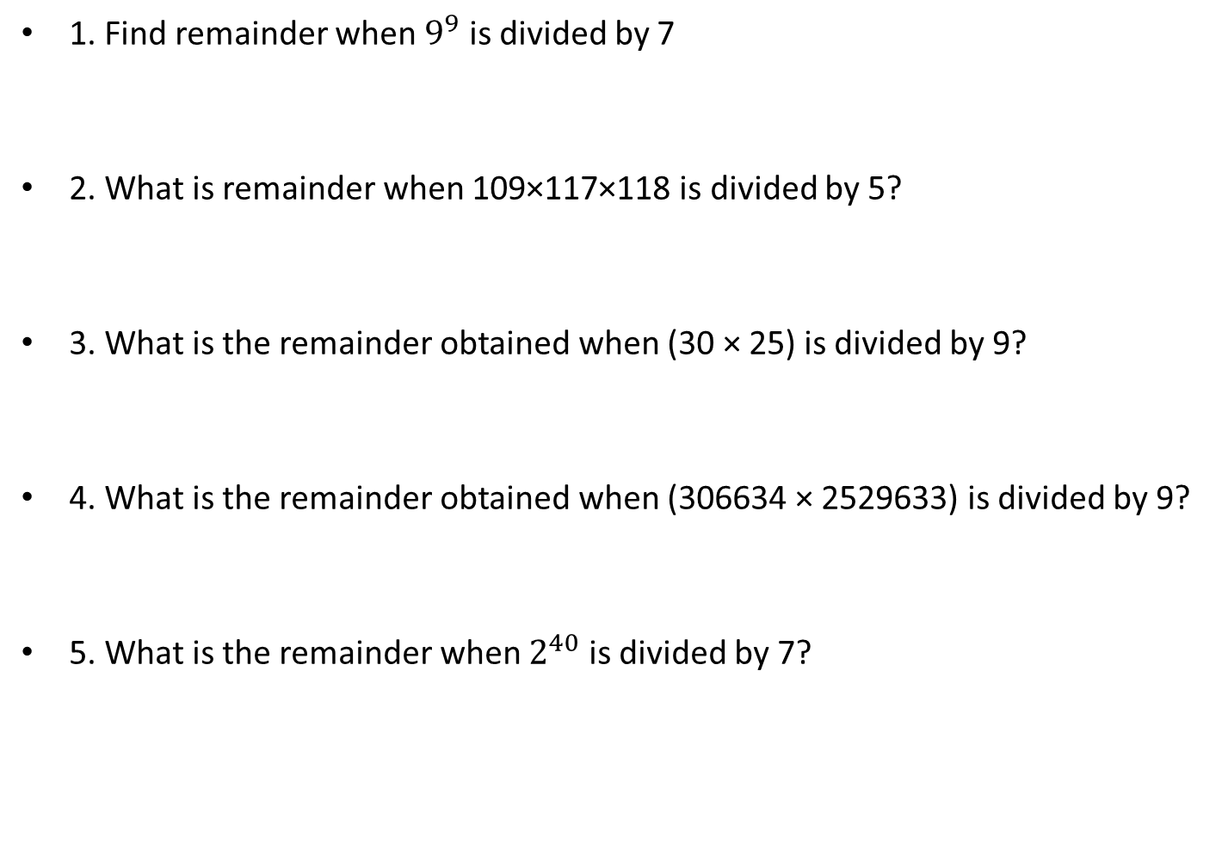
Questions- Remainders
1. Find remainder when $9^{9}$ is divided by 7
2. What is remainder when 109×117×118 is divided by 5?
3. What is the remainder obtained when (30 × 25) is divided by 9?
4. What is the remainder obtained when (306634 × 2529633) is divided by 9?
5. What is the remainder when $2^{40}$ is divided by 7?

Slide 16
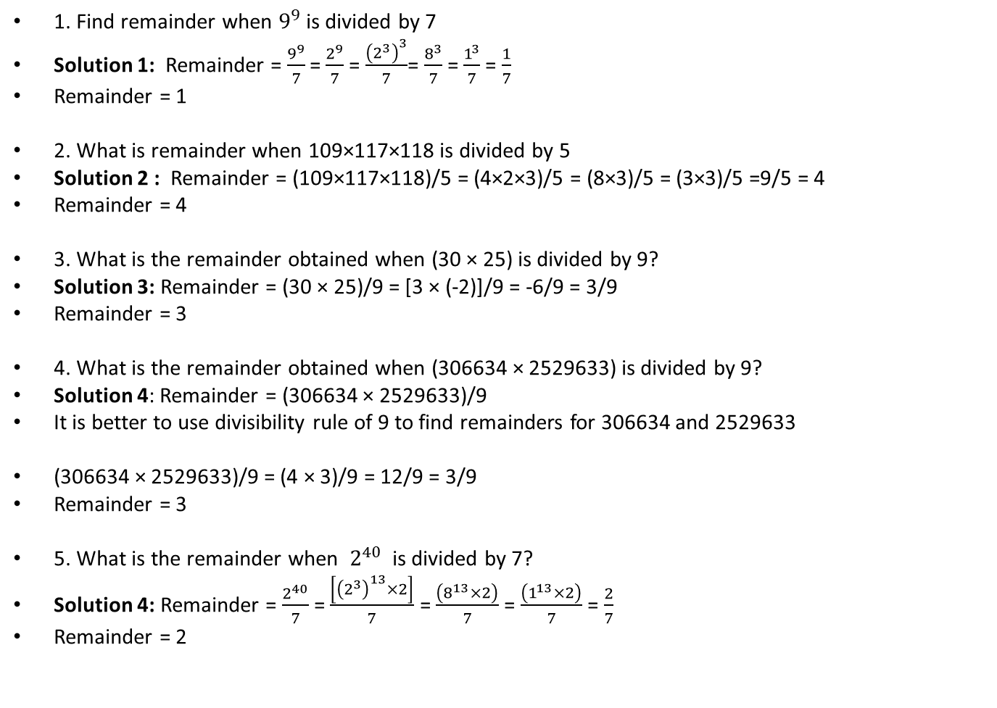
Solutions
1. Find remainder when $9^{9}$ is divided by 7
Solution 1: Remainder = $\frac{9^{9}}{7}$= $\frac{2^{9}}{7}$= $\frac{{\left(2^{3}\right)}^{3}}{7}$= $\frac{8^{3}}{7}$= $\frac{1^{3}}{7}$= $\frac{1}{7}$
Remainder = 1
2. What is remainder when 109×117×118 is divided by 5
Solution 2 : Remainder = (109×117×118)/5 = (4×2×3)/5 = (8×3)/5 = (3×3)/5 =9/5 = 4
Remainder = 4
3. What is the remainder obtained when (30 × 25) is divided by 9?
Solution 3: Remainder = (30 × 25)/9 = [3 × (-2)]/9 = -6/9 = 3/9
Remainder = 3
4. What is the remainder obtained when (306634 × 2529633) is divided by 9?
Solution 4: Remainder = (306634 × 2529633)/9
It is better to use divisibility rule of 9 to find remainders for 306634 and 2529633
(306634 × 2529633)/9 = (4 × 3)/9 = 12/9 = 3/9
Remainder = 3
5. What is the remainder when $2^{40}$ is divided by 7?
Solution 4: Remainder = $\frac{2^{40}}{7}$ = $\frac{\left[{\left(2^{3}\right)}^{13}×2\right]}{7}$ = $\frac{\left(8^{13}×2\right)}{7}$ = $\frac{\left(1^{13}×2\right)}{7}$ = $\frac{2}{7}$
Remainder = 2

Slide 17
Concept of Last digit
Last digit – The last digit of any number or a mathematical expression is the remainder when the given number or mathematical expression is divided by 10
Last 2 digits- The last 2 digits of any number or a mathematical expression is the remainder when the given number or mathematical expression is divided by 100
Similarly last 3 digits, last 4 digits etc. can be obtained
Mainly questions are asked for last digit only

Slide 18
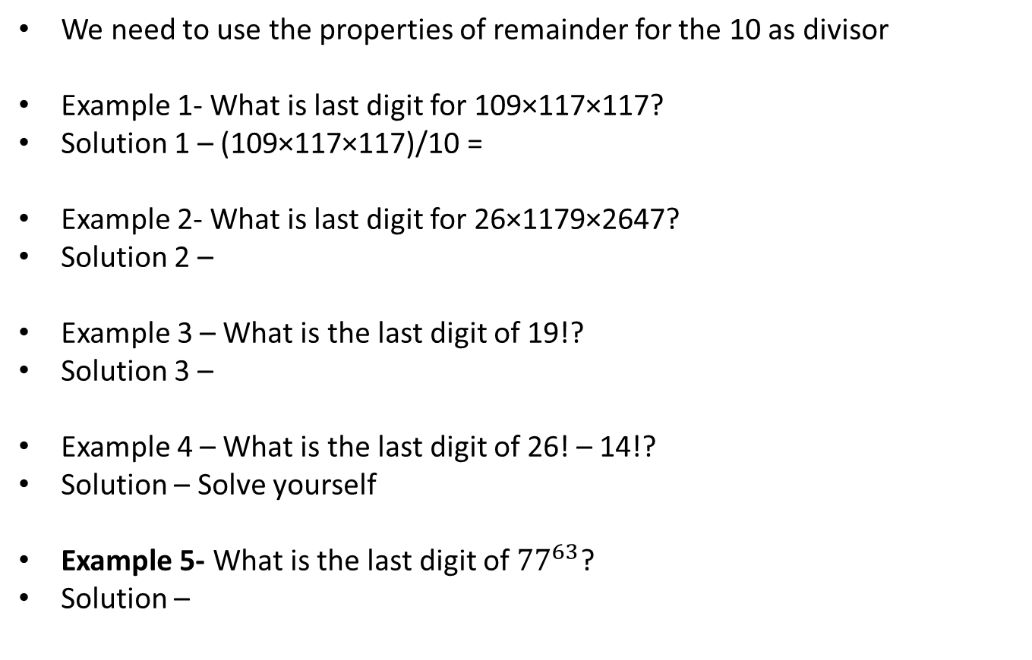
Last digit for a mathematical expression
We need to use the properties of remainder for the 10 as divisor
Example 1- What is last digit for 109×117×117?
Solution 1 – (109×117×117)/10 =
Example 2- What is last digit for 26×1179×2647?
Solution 2 –
Example 3 – What is the last digit of 19!?
Solution 3 –
Example 4 – What is the last digit of 26! – 14!?
Solution – Solve yourself
Example 5- What is the last digit of ${77}^{63}$?
Solution –

Slide 19
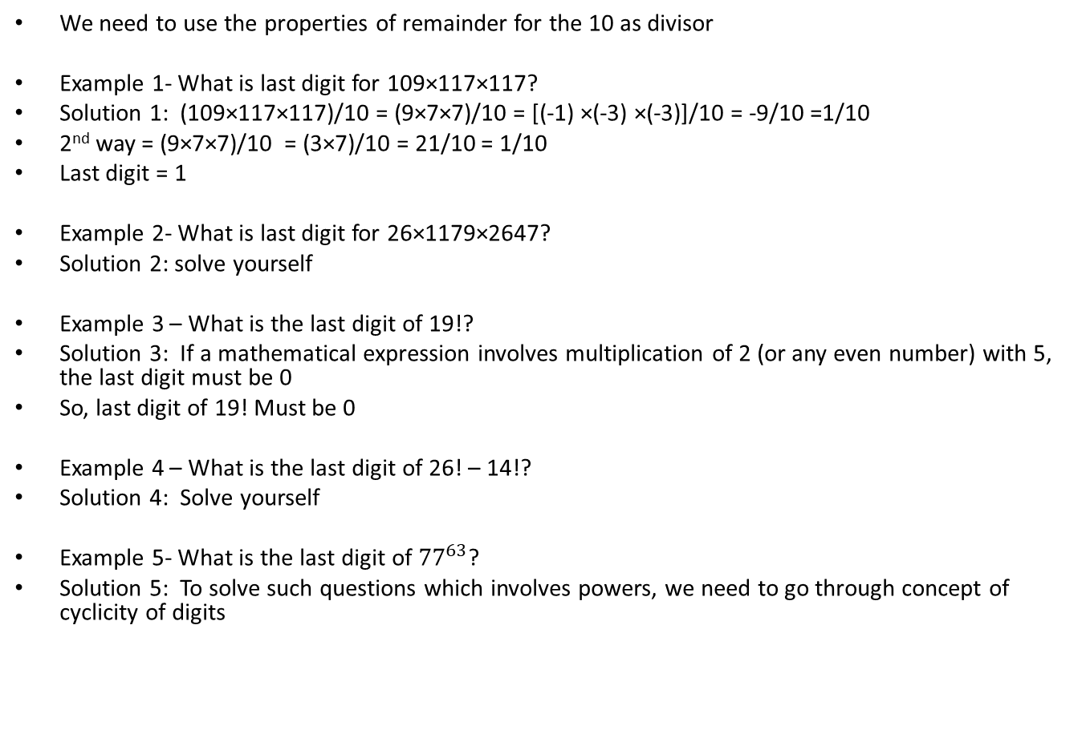
Last digit for a mathematical expression
We need to use the properties of remainder for the 10 as divisor
Example 1- What is last digit for 109×117×117?
Solution 1: (109×117×117)/10 = (9×7×7)/10 = [(-1) ×(-3) ×(-3)]/10 = -9/10 =1/10
2nd way = (9×7×7)/10 = (3×7)/10 = 21/10 = 1/10
Last digit = 1
Example 2- What is last digit for 26×1179×2647?
Solution 2: solve yourself
Example 3 – What is the last digit of 19!?
Solution 3: If a mathematical expression involves multiplication of 2 (or any even number) with 5, the last digit must be 0
So, last digit of 19! Must be 0
Example 4 – What is the last digit of 26! – 14!?
Solution 4: Solve yourself
Example 5- What is the last digit of ${77}^{63}$?
Solution 5: To solve such questions which involves powers, we need to go through concept of cyclicity of digits

Slide 20
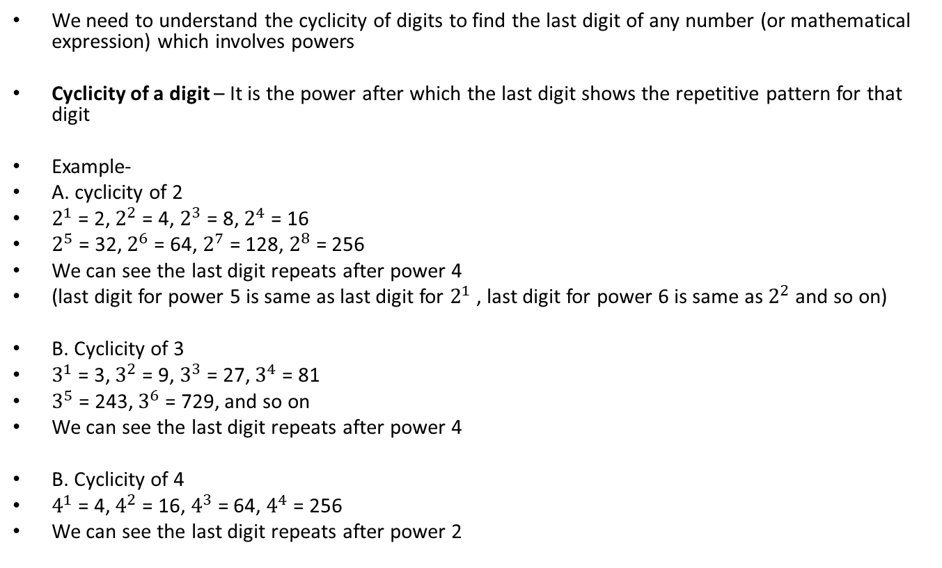
Cyclicity of digits
We need to understand the cyclicity of digits to find the last digit of any number (or mathematical expression) which involves powers
Cyclicity of a digit – It is the power after which the last digit shows the repetitive pattern for that digit
Example-
A. cyclicity of 2
$2^{1}$ = 2, $2^{2}$ = 4, $2^{3}$ = 8, $2^{4}$ = 16
$2^{5}$ = 32, $2^{6}$ = 64, $2^{7}$ = 128, $2^{8}$ = 256
We can see the last digit repeats after power 4
(last digit for power 5 is same as last digit for $2^{1}$ , last digit for power 6 is same as $2^{2}$ and so on)
B. Cyclicity of 3
$3^{1}$ = 3, $3^{2}$ = 9, $3^{3}$ = 27, $3^{4}$= 81
$3^{5}$ = 243, $3^{6}$ = 729, and so on
We can see the last digit repeats after power 4
B. Cyclicity of 4
$4^{1}$ = 4, $4^{2}$ = 16, $4^{3}$ = 64, $4^{4}$ = 256
We can see the last digit repeats after power 2

Slide 21
Cyclicity of 0,1,5 and 6 = 1
Cyclicity of 4, 9 = 2
Cyclicity of 2, 3, 7, 8 = 4

Slide 22
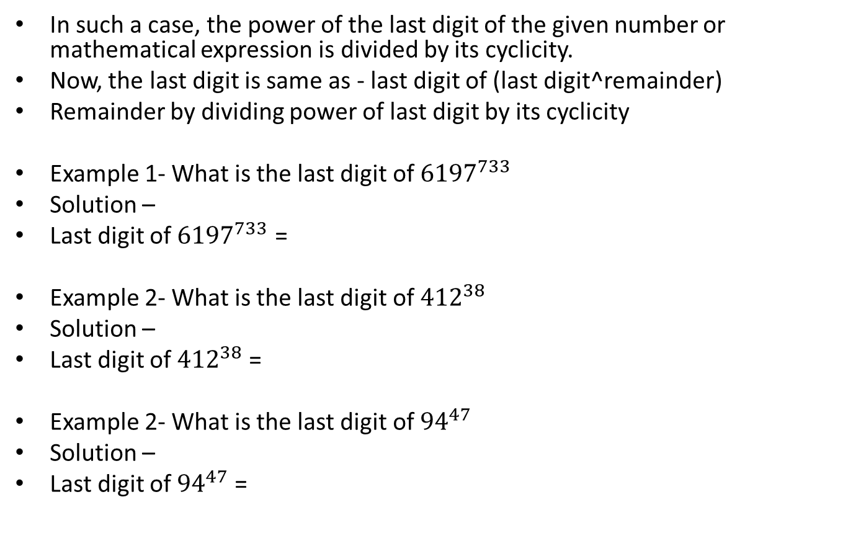
Last digit involving powers
In such a case, the power of the last digit of the given number or mathematical expression is divided by its cyclicity.
Now, the last digit is same as - last digit of (last digit^remainder)
Remainder by dividing power of last digit by its cyclicity
Example 1- What is the last digit of ${6197}^{733}$
Solution –
Last digit of ${6197}^{733}$ =
Example 2- What is the last digit of ${412}^{38}$
Solution –
Last digit of ${412}^{38}$=
Example 2- What is the last digit of ${94}^{47}$
Solution –
Last digit of ${94}^{47}$=

Slide 23
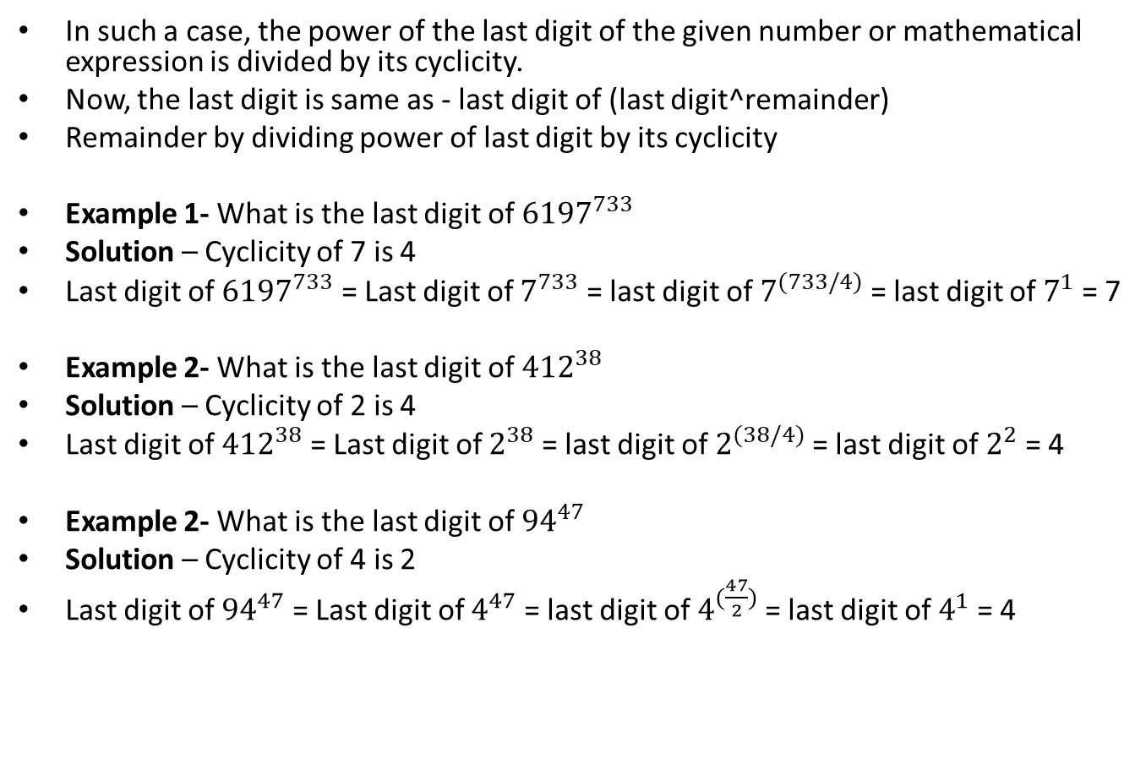
Last digit involving powers
In such a case, the power of the last digit of the given number or mathematical expression is divided by its cyclicity.
Now, the last digit is same as - last digit of (last digit^remainder)
Remainder by dividing power of last digit by its cyclicity
Example 1- What is the last digit of ${6197}^{733}$
Solution – Cyclicity of 7 is 4
Last digit of ${6197}^{733}$ = Last digit of $7^{733}$ = last digit of $7^{(733/4)}$ = last digit of $7^{1}$ = 7
Example 2- What is the last digit of ${412}^{38}$
Solution – Cyclicity of 2 is 4
Last digit of ${412}^{38}$ = Last digit of $2^{38}$ = last digit of $2^{(38/4)}$= last digit of $2^{2}$ = 4
Example 2- What is the last digit of ${94}^{47}$
Solution – Cyclicity of 4 is 2
Last digit of ${94}^{47}$ = Last digit of $4^{47}$ = last digit of $4^{(\frac{47}{2})}$= last digit of $4^{1}$ = 4

Slide 24
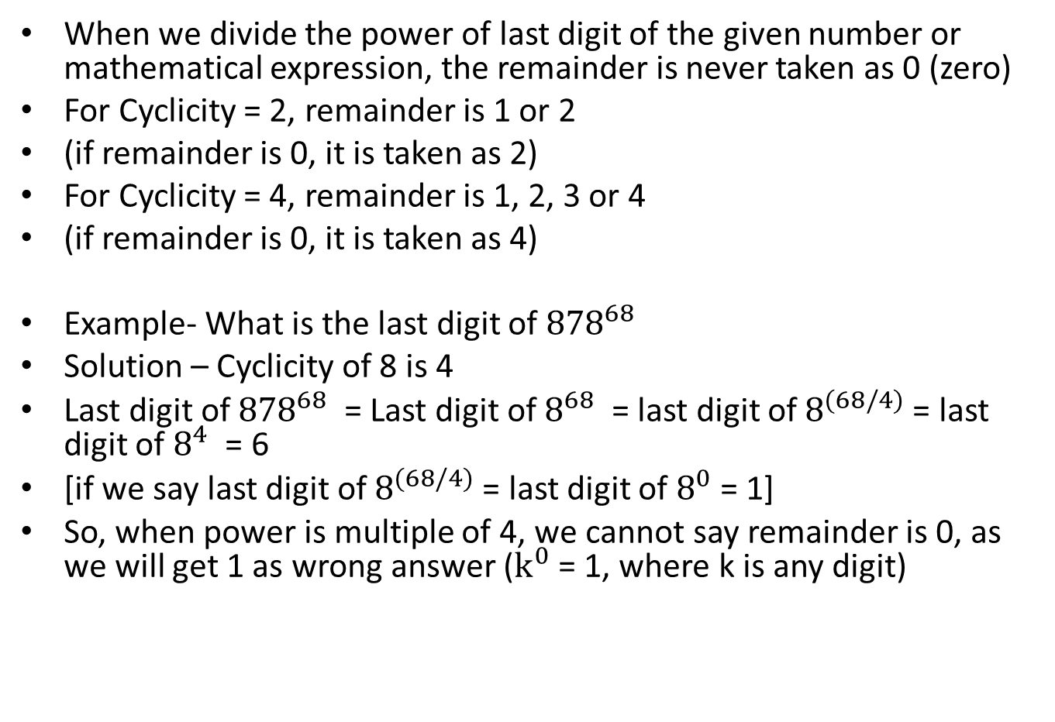
Point to remember
When we divide the power of last digit of the given number or mathematical expression, the remainder is never taken as 0 (zero)
For Cyclicity = 2, remainder is 1 or 2
(if remainder is 0, it is taken as 2)
For Cyclicity = 4, remainder is 1, 2, 3 or 4
(if remainder is 0, it is taken as 4)
Example- What is the last digit of ${878}^{68}$
Solution – Cyclicity of 8 is 4
Last digit of ${878}^{68}$ = Last digit of $8^{68}$ = last digit of $8^{(68/4)}$= last digit of $8^{4}$ = 6
[if we say last digit of $8^{(68/4)}$= last digit of $8^{0}$ = 1]
So, when power is multiple of 4, we cannot say remainder is 0, as we will get 1 as wrong answer ($k^{0}$= 1, where k is any digit)

Slide 25
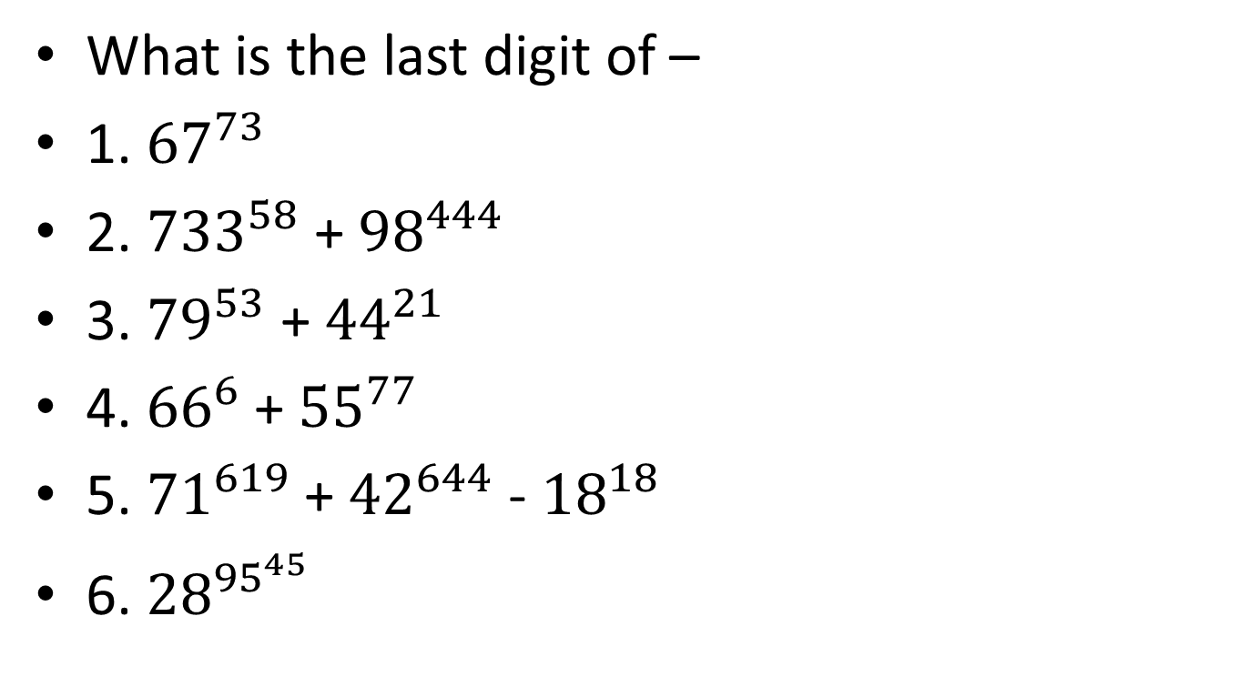
Some examples of last digit based on power
What is the last digit of –
1. ${67}^{73}$
2. ${733}^{58}$+ ${98}^{444}$
3. ${79}^{53}$+ ${44}^{21}$
4. ${66}^{6}$+ ${55}^{77}$
5. ${71}^{619}$+ ${42}^{644}$- ${18}^{18}$
6. ${28}^{{95}^{45}}$

Slide 26
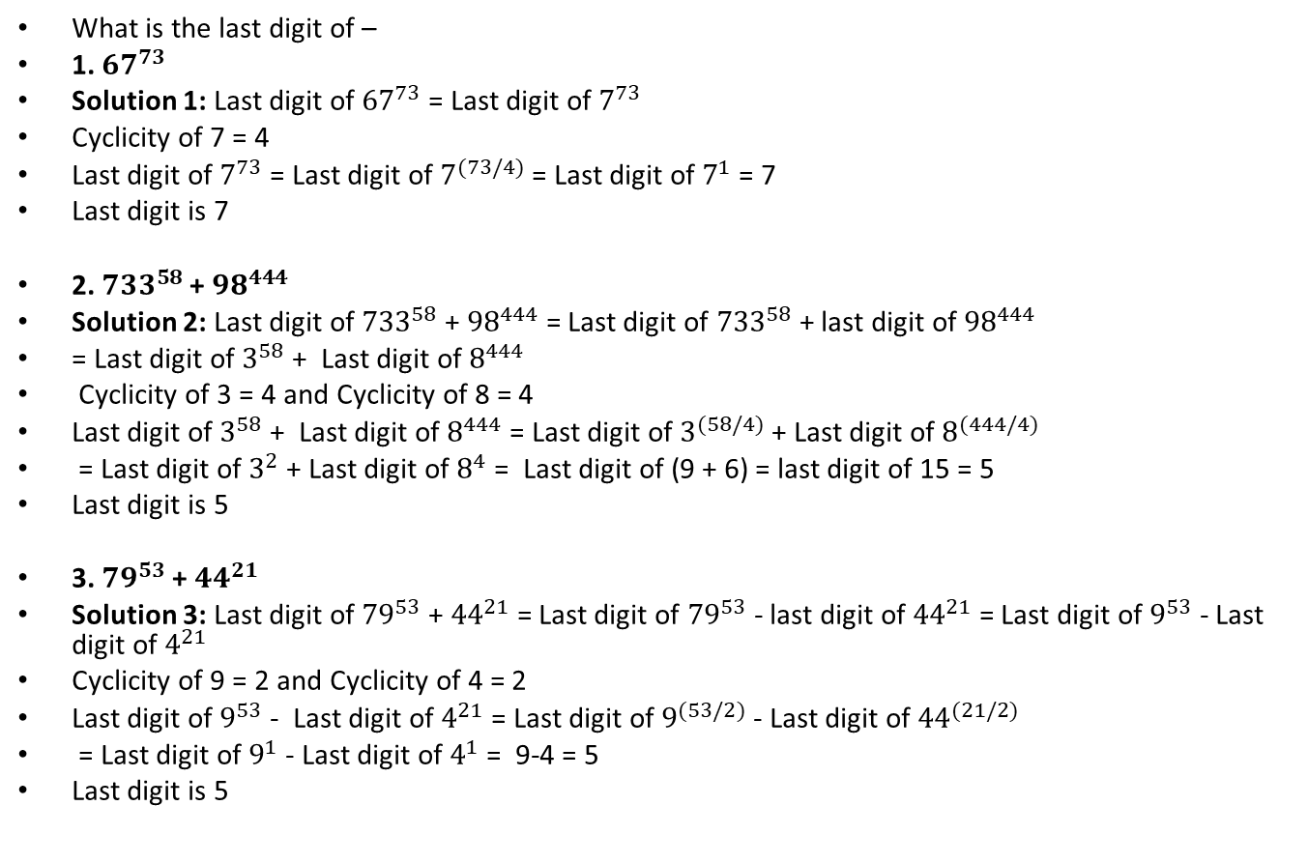
Some examples of last digit based on power
What is the last digit of –
1. ${67}^{73}$
Solution 1: Last digit of ${67}^{73}$= Last digit of $7^{73}$
Cyclicity of 7 = 4
Last digit of $7^{73}$= Last digit of $7^{(73/4)}$= Last digit of $7^{1}$= 7
Last digit is 7
2. ${733}^{58}$+ ${98}^{444}$
Solution 2: Last digit of ${733}^{58}$+ ${98}^{444}$= Last digit of ${733}^{58}$+ last digit of ${98}^{444}$
= Last digit of $3^{58}$+ Last digit of $8^{444}$
Cyclicity of 3 = 4 and Cyclicity of 8 = 4
Last digit of $3^{58}$+ Last digit of $8^{444}$= Last digit of $3^{(58/4)}$+ Last digit of $8^{(444/4)}$
= Last digit of $3^{2}$ + Last digit of $8^{4}$ = Last digit of (9 + 6) = last digit of 15 = 5
Last digit is 5
3. ${79}^{53}$+ ${44}^{21}$
Solution 3: Last digit of ${79}^{53}$+ ${44}^{21}$= Last digit of ${79}^{53}$- last digit of ${44}^{21}$= Last digit of $9^{53}$- Last digit of $4^{21}$
Cyclicity of 9 = 2 and Cyclicity of 4 = 2
Last digit of $9^{53}$- Last digit of $4^{21}$= Last digit of $9^{(53/2)}$- Last digit of ${44}^{(21/2)}$
= Last digit of $9^{1}$ - Last digit of $4^{1}$= 9-4 = 5
Last digit is 5

Slide 27
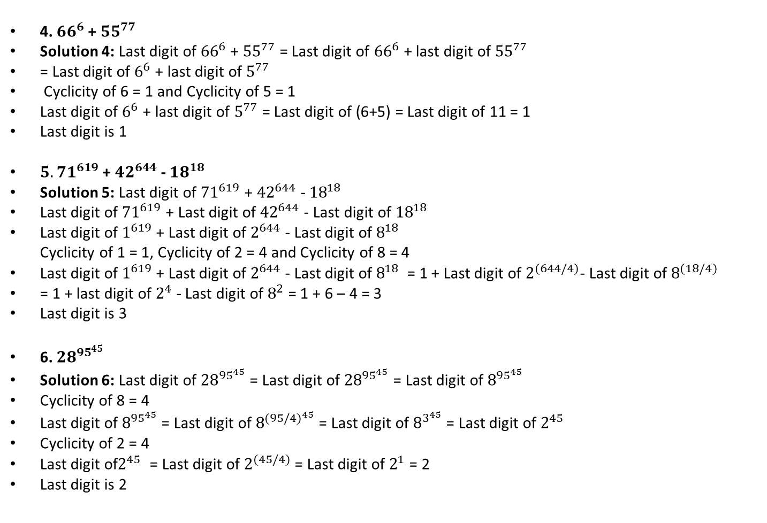
4. ${66}^{6}$+ ${55}^{77}$
Solution 4: Last digit of ${66}^{6}$+ ${55}^{77}$= Last digit of ${66}^{6}$+ last digit of ${55}^{77}$
= Last digit of $6^{6}$+ last digit of $5^{77}$
Cyclicity of 6 = 1 and Cyclicity of 5 = 1
Last digit of $6^{6}$+ last digit of $5^{77}$= Last digit of (6+5) = Last digit of 11 = 1
Last digit is 1
${5. 71}^{619}$+ ${42}^{644}$- ${18}^{18}$
Solution 5: Last digit of ${71}^{619}$+ ${42}^{644}$- ${18}^{18}$
Last digit of ${71}^{619}$+ Last digit of ${42}^{644}$- ${\text{Last} \text{digit} \text{of} 18}^{18}$
Last digit of $1^{619}$+ Last digit of $2^{644}$- ${\text{Last} \text{digit} \text{of} 8}^{18}$
Cyclicity of 1 = 1, Cyclicity of 2 = 4 and Cyclicity of 8 = 4
Last digit of $1^{619}$+ Last digit of $2^{644}$- ${\text{Last} \text{digit} \text{of} 8}^{18}$= 1 + Last digit of $2^{(644/4)}$- Last digit of $8^{(18/4)}$
= 1 + last digit of $2^{4}$ - Last digit of $8^{2}$ = 1 + 6 – 4 = 3
Last digit is 3
6. ${28}^{{95}^{45}}$
Solution 6: Last digit of ${28}^{{95}^{45}}$= Last digit of ${28}^{{95}^{45}}$= Last digit of $8^{{95}^{45}}$
Cyclicity of 8 = 4
Last digit of $8^{{95}^{45}}$= Last digit of $8^{{(95/4)}^{45}}$= Last digit of $8^{3^{45}}$= Last digit of $2^{45}$
Cyclicity of 2 = 4
Last digit of$2^{45}$ = Last digit of $2^{(45/4)}$= Last digit of $2^{1}$ = 2
Last digit is 2

